Slide 1
Marinus Toman, PhD Researcher Intelligent Systems Research Centre, School of Computing, Engineering & Intelligent Systems Ulster University, Magee, Derry
Computational Neuroscience with CNET

Slide 2
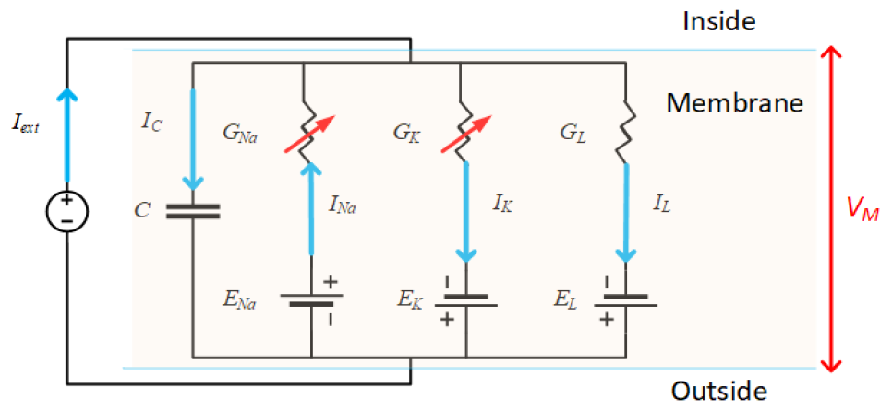
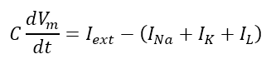
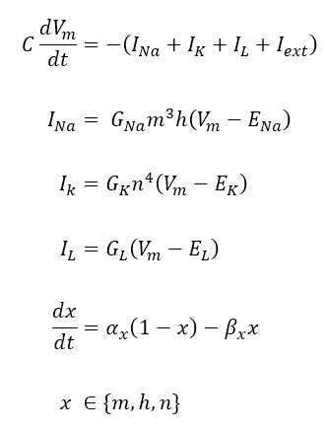
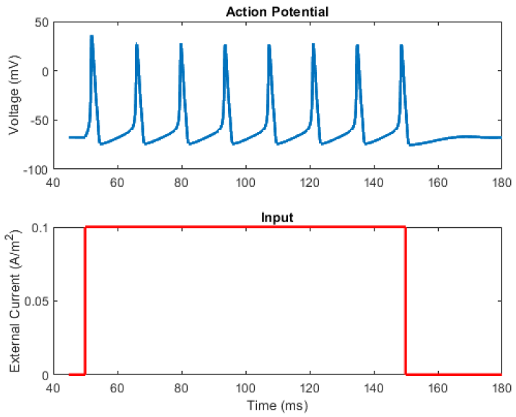
Neuron Action Potential Model
Changing Membrane Potential
Ion Channel Currents
Ion Channel Gating Kinetics

Slide 3
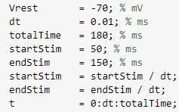
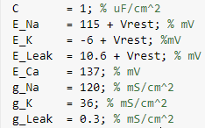
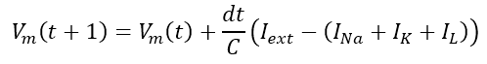
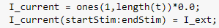
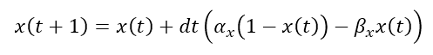
Coding Action Potential Model
Mathematical AP Model
MATLAB AP Model Code
1
2
3
4
5
6
7
8
9
10
11
12
13
14
15
16
17
18
Q. First thing to do?
Euler’s Forward Method of Integration
A. Set model constants

Slide 4
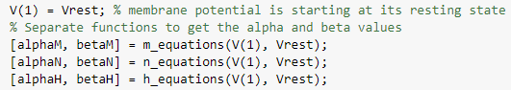
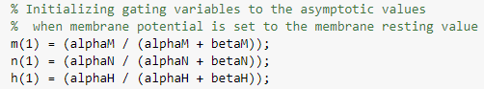
Coding Action Potential Model
Mathematical AP Model
MATLAB AP Model Code
19
20
21
22
23
24
25
26
27
28
Q. First thing to do?
Euler’s Forward Method of Integration
A. Set model constants

Slide 5
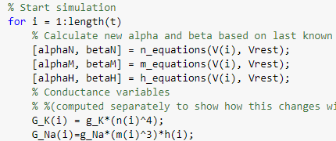
Coding Action Potential Model
Mathematical AP Model
MATLAB AP Model Code
29
30
31
32
33
34
35
36
37
38
Q. Next thing to do?
Euler’s Forward Method of Integration
A. Start simulation!

Slide 6
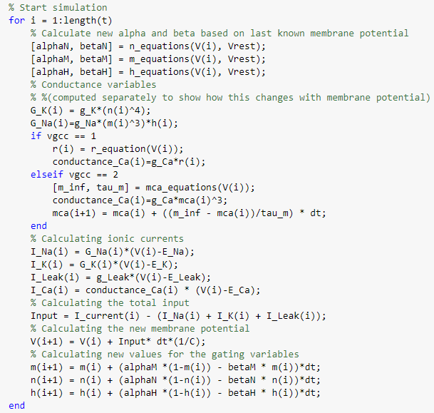
Coding Action Potential Model
Mathematical AP Model
MATLAB AP Model Code
39
40
41
42
43
44
Q. Next thing to do?
Euler’s Forward Method of Integration
A. Use equations!

Slide 7
Coding Action Potential Model
Mathematical AP Model
MATLAB AP Model Code
45
46
47
48
49
50
51
Q. Next thing to do?
Euler’s Forward Method of Integration
A. Solve!

Slide 8
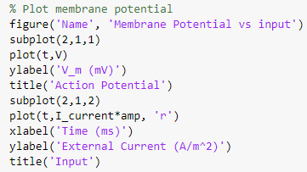
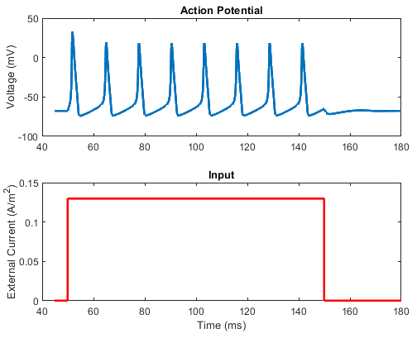
Coding Action Potential Model
Mathematical AP Model
MATLAB AP Model Code
52
53
54
55
56
57
58
59
60
61
62
Q. Next thing to do?
Euler’s Forward Method of Integration
A. Plot Results!

Slide 9
Marinus Toman, PhD Researcher Intelligent Systems Research Centre, School of Computing, Engineering & Intelligent Systems Ulster University, Magee, Derry
Computational Neuroscience with CNET

